Slide 1
Consumer Buying Behavior
Chapter 7

Slide 2
Learning Objectives
LO 7-1 Recognize the stages of the consumer buying decision process.
LO 7-2 Describe the types of consumer decision making and the level
of involvement.
LO 7-3 Explain how situational influences may affect the consumer buying decision process.
LO 7-4 Identify the psychological influences that may affect the consumer buying decision process.
LO 7-5 Describe the social influences that may affect the consumer buying decision process.
LO 7-6 Discuss consumer misbehavior.

Slide 3
Buying Behavior
Buying behavior – The decision processes and actions of people involved in buying and using products
Consumer buying behavior – The decision processes and purchasing activities of people who purchase products for personal or household use and not for business purposes

Slide 4
Understanding Buyer Behavior
Marketers attempt to understand buying behavior for several reasons:
  Customers’ overall opinions and attitudes toward a firm’s products have a great impact on the firm’s success
  To find out what satisfies buyers, marketers must examine the main influences on what, where, when, and how consumers buy
  By gaining a deeper understanding of the factors that affect buying behavior, marketers are better-positioned to predict how consumers will respond to marketing strategies

Slide 5
Consumer Buying Decision Process
Consumer buying decision process – A five-stage purchase decision process that includes:
  Problem recognition
  Information search
  Evaluation of alternatives
  Purchase
  Postpurchase evaluation

Slide 6
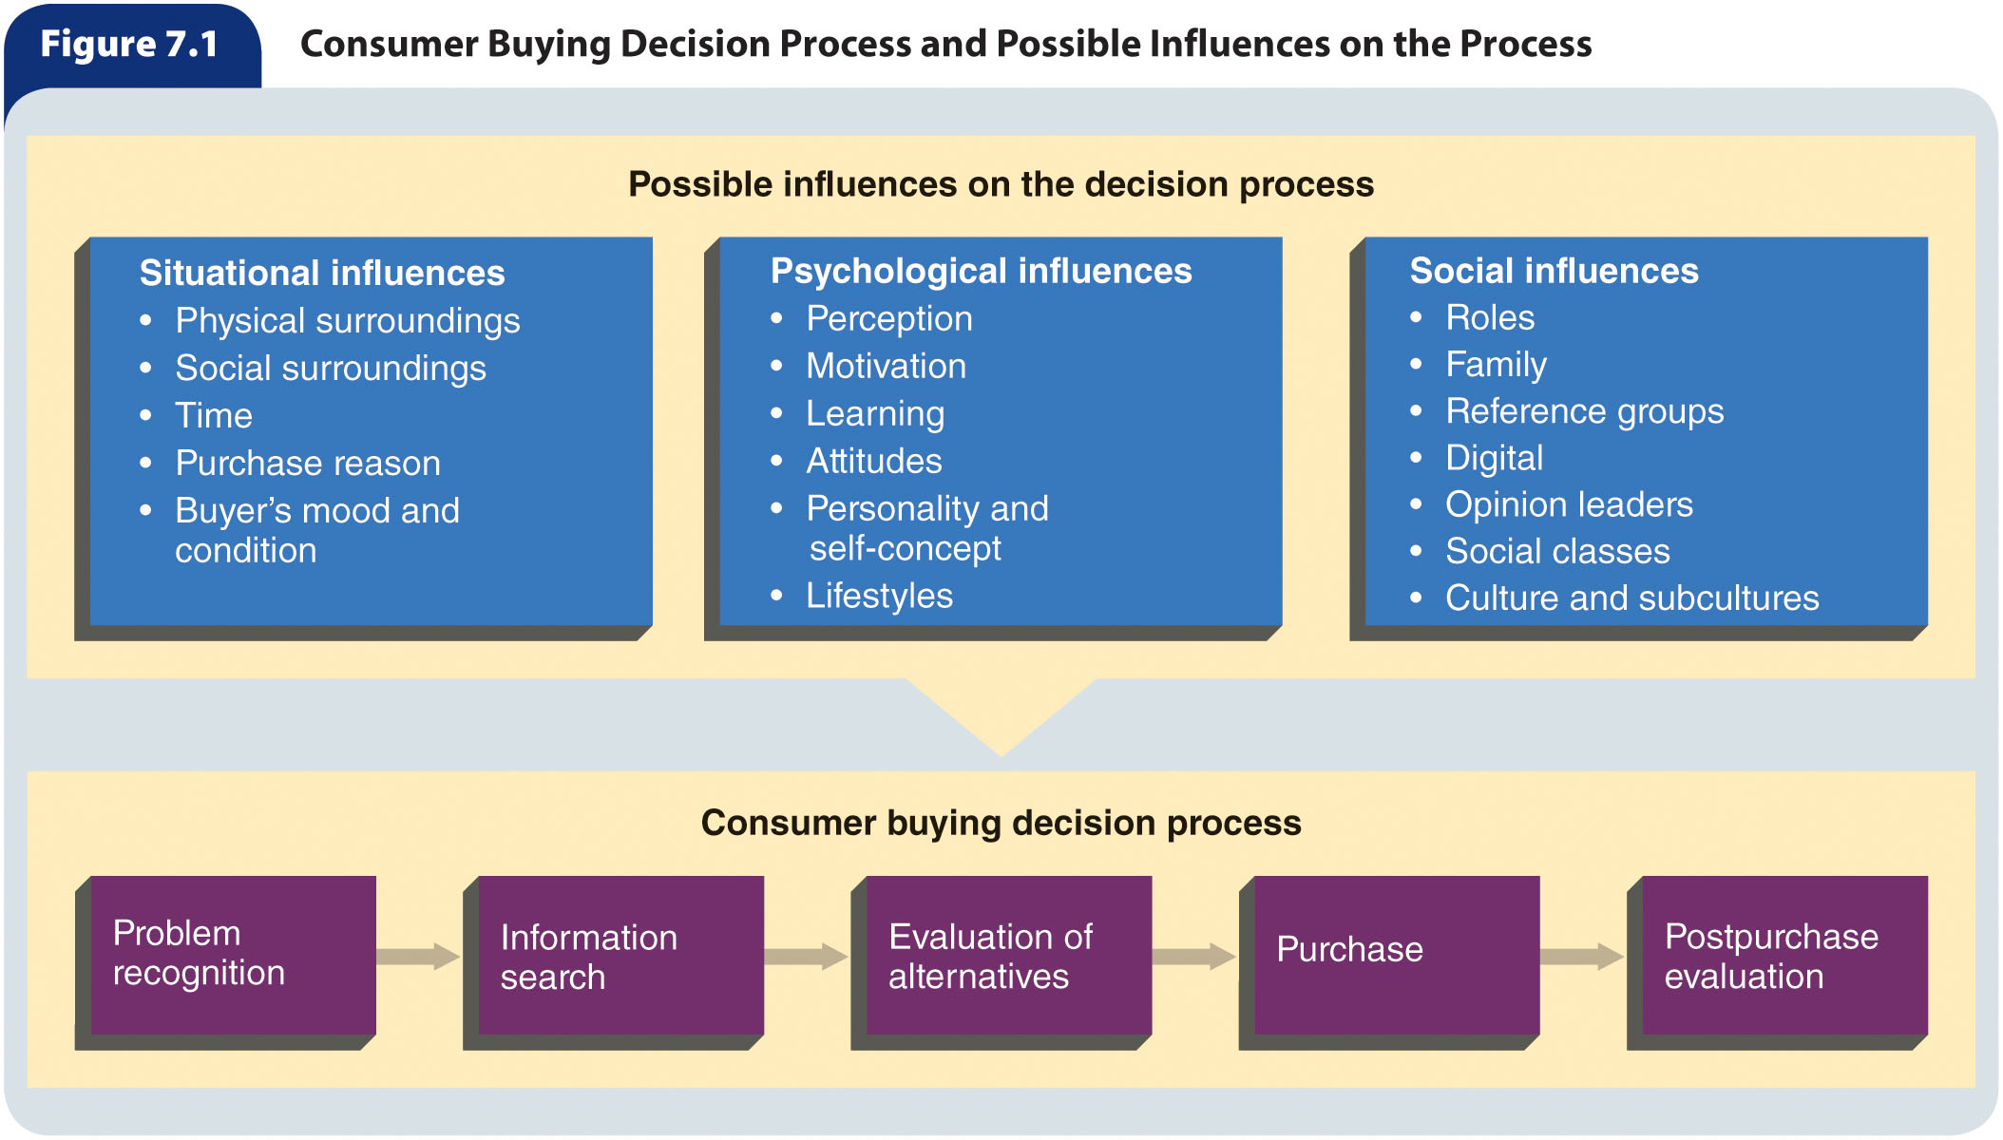
Figure 7.1 – Consumer Buying Decisions Process and Possible Influences on the Process

Slide 7
Problem Recognition
Problem recognition occurs when a buyer becomes aware of a difference between a desired state and an actual condition
  The speed of consumer problem recognition can be quite rapid or rather slow
  Sometimes a person has a problem or need but is unaware of it
    Marketers use sales personnel, advertising, and packaging to help trigger recognition of such needs or problems

Slide 8
Information Search
After recognizing the problem or need, a buyer will decide whether to pursue satisfying that need
  If the consumer chooses to move forward, he or she will next search for product information to help resolve the problem or satisfy the need
An information search has two aspects:
  Internal search – An information search in which buyers search their memories for information about products that might solve their problem
  External search – An information search in which buyers seek information from sources other than their memories
    Personal contacts often are influential sources of information
    The Internet has become a major resource during the consumer buying decision process
    Buyers can also obtain information from independent sources, such as government reports, news presentations, publications such as Consumer Reports, and reports from product-testing organizations

Slide 9
Evaluation of Alternatives
Consideration set (evoked set) – A group of brands within a product category that a buyer views as alternatives for possible purchase
Evaluative criteria – Objective and subjective product characteristics that are important to a buyer
Marketers may influence consumers’ evaluations by framing the alternatives—that is, describing the alternatives and their attributes in a certain manner
  Framing can make a characteristic seem more important to a consumer and facilitate its recall from memory
  Framing has a stronger influence on the decision processes of inexperienced buyers

Slide 10
Purchase Stage
In the purchase stage, the buyer:
  Chooses to purchase the product or brand yielded by the evaluation of alternatives
    Product availability may influence which brand is ultimately purchased
  Picks the seller from which he or she will buy the product
  Negotiates the terms of the sale
  Settles other issues, such as price, delivery, warranties, maintenance agreements, installation, and credit arrangements
  Makes the actual purchases or terminates the buying decision process

Slide 11
Postpurchase Evaluation
After the purchase, the buyer evaluates the product to ascertain if its actual performance meets expected levels
The outcome of this stage is either satisfaction or dissatisfaction
Cognitive dissonance – A buyer’s doubts shortly after a purchase about whether the decision was the right one
  Most likely to arise when a person recently bought an expensive, high-involvement product that is found to be lacking some of the desirable features of competing brands
  A buyer who is experiencing cognitive dissonance may attempt to return the product or may seek out positive information, such as reviews, to justify choosing it

Slide 12
Consumer Decision Making (slide 1 of 2)
There are three types of consumer decision making, which vary in involvement level and other factors:
  Routinized response behavior
  Limited decision making
  Extended decision making

Slide 13
Table 7.1 – Consumer Decision Making
 | Routinized Response | Limited | Extended
Product cost | Low | Low to moderate | High
Search effort | Little | Little to moderate | Extensive
Time spent | Short | Short to medium | Lengthy
Brand preference | More than one is acceptable, although one is preferred | Several | Varies, usually many

Slide 14
Consumer Decision Making (slide 2 of 2)
Routinized response behavior – A consumer decision-making process used when buying frequently purchased, low-cost items that require very little search-and-decision effort
  Selecting most supermarket items such as soft drinks or batteries
Limited decision making – A consumer decision-making process used when purchasing products occasionally or needing information about an unfamiliar brand in a familiar product category
  Requires slightly more time for information gathering and deliberation
Extended decision making – A consumer decision-making process employed when purchasing unfamiliar, expensive, or infrequently
bought products
  Purchasing a computer, car, or the services of a doctor or lawyer
Consumer decision making is not always rational
  Impulse buying – An unplanned buying behavior resulting from a powerful urge to
  buy something immediately

Slide 15
Consumer Level of Involvement
Level of involvement – An individual’s degree of interest in a product and the importance of the product for that person
  High-involvement products tend to be those that are visible to others (e.g., real estate, high-end electronics, or automobiles) and are more expensive
    High-importance issues, such as health care, are also associated with high levels of involvement
  Low-involvement products are much less expensive and have less associated social risk (e.g., grocery or drugstore items)
Enduring involvement – Ongoing and long-term involvement with a product or product category
Situational involvement – Temporary and dynamic involvement resulting from a particular set of circumstances

Slide 16
Situational Influences on the
Buying Decision Process (slide 1 of 3)
Situational influences – Influences that result from circumstances, time, and location that affect the consumer buying decision process
  Can influence the buyer during any stage of the decision-making process and may cause the individual to shorten, lengthen, or terminate the process
Five categories of situational influences:
  Physical surroundings
  Social surroundings
  Time perspective
  Reason for purchase
  The buyer’s momentary mood and condition

Slide 17
Situational Influences on the
Buying Decision Process (slide 2 of 3)
Physical surroundings include location, store atmosphere, scents, sounds, lighting, weather, and other factors in the physical environment in which the decision process occurs
Social surroundings include characteristics and interactions of others who are present during a purchase decision, such as friends, relatives, salespeople, and other customers
The time dimension influences the buying decision process in several ways
  It takes varying amounts of time to progress through the steps of the buying decision process, including learning about, searching for, purchasing, and using a product
  Time also plays a major role when consumers consider the frequency of product use, the length of time required to use it, and the overall product life
  Other time dimensions that can influence purchases include time of day, day of the week or month, seasons, and holidays

Slide 18
Situational Influences on the
Buying Decision Process (slide 3 of 3)
The reason for purchase involves what exactly the product purchase should accomplish and for whom
The buyer’s moods (e.g., anger, anxiety, or contentment) or conditions (e.g., fatigue, illness, or having cash on hand) may affect the consumer buying decision process
  Such moods or conditions are momentary and occur immediately before the situation where a buying decision will be made
  They can affect a person’s ability and desire to search for or receive information, or seek and evaluate alternatives
  Moods can also significantly influence a consumer’s postpurchase evaluation

Slide 19
Psychological Influences on the
Buying Decision Process
Psychological influences – Factors that in part determine people’s general behavior, thus influencing their behavior as consumers
  Operate on buyers internally, but are strongly affected by external social forces
Six categories of psychological influences: perception, motives, learning, attitudes, personality and self concept, and lifestyles.

Slide 20
Perception
Perception – The process of selecting, organizing, and interpreting information inputs to produce meaning
Information inputs – Sensations received through sight, taste, hearing, smell, and touch
Selective exposure – The process by which some inputs are selected to reach awareness and others are not
The selective nature of perception may result in two conditions:
  Selective distortion – An individual’s changing or twisting of information that is inconsistent with personal feelings or beliefs
  Selective retention – Remembering information inputs that support personal feelings and beliefs and forgetting inputs that do not

Slide 21
The Perception Process
Selection
  Perception can be interpreted in different ways because only some reach our awareness
Perceptual organization
  Information inputs that reach awareness are not received in an organized form
    People use several methods to achieve this
      One method is figure-ground
      Another method is called closure
Interpretation
  Is the assignment of meaning to what has been organized

Slide 22
Motives
Motive – An internal energizing force that directs a person’s behavior toward satisfying needs or achieving goals
  Can be physical feelings, states of mind, or emotions
Maslow’s hierarchy of needs – The five levels of needs that humans seek to satisfy, from most to least important
  Physiological needs – Requirements for survival such as food, water, sex, clothing, and shelter
  Safety needs – Include security and freedom from physical and emotional pain and suffering
  Social needs – Human requirements for love and affection and a sense of belonging
  Esteem needs – Requirements of respect and recognition from others as well as self-esteem, a sense of one’s own worth
  Self-actualization needs – People’s needs to grow and develop and to become all they are capable of becoming

Slide 23
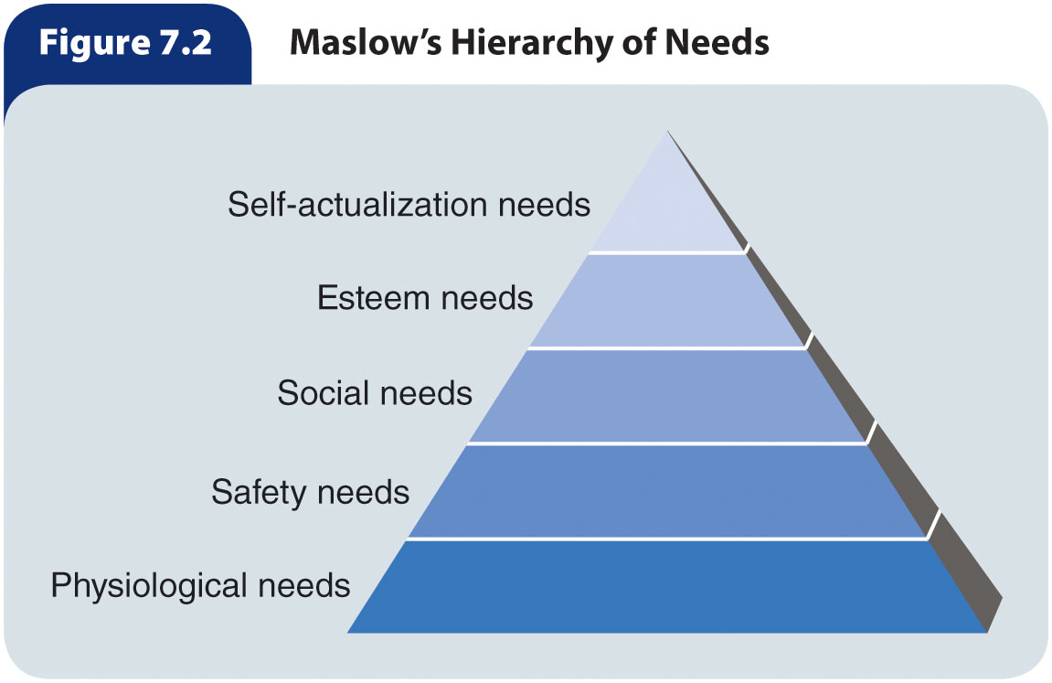
Figure 7.2 – Maslow’s Hierarchy of Needs

Slide 24
Learning
Learning – Changes in an individual’s thought processes and behavior caused by information and experience
  Sources of learning:
    Consequences of behavior
    Information processing
    Experience

Slide 25
Attitudes (slide 1 of 2)
Attitude – An individual’s enduring evaluation of feelings about and behavioral tendencies toward an object or idea
  Acquired through experience and interaction with other people
  Consists of three major components:
    Cognitive – Knowledge and information about the object or idea
    Affective – Feelings and emotions toward the object or idea
    Behavioral – Actions regarding the object or idea

Slide 26
Attitudes (slide 2 of 2)
Efforts to understand attitudes has resulted in two major academic models:
  Attitude toward the object (the Fishbein model)
    Can be used to understand, and possibly predict, a consumer’s attitude
    Consists of three elements:
      Beliefs about product attributes
      The strength of beliefs
      The evaluation of beliefs
  Behavioral intentions model (the Theory of Reasoned Action)
    Rather than focusing on attributes, focuses on intentions to act or purchase
    Considers consumer perceptions of what other people, particularly peers, believe is the best choice among a set of alternatives
Attitude scale – A means of measuring consumer attitudes by gauging the intensity of individuals’ reactions to adjectives, phrases, or sentences about an object

Slide 27
Personality
Personality – A set of internal traits and distinct behavioral tendencies that result in consistent patterns of behavior in certain situations
  An individual’s personality is a unique combination of heredity characteristics and personal experiences
  There is a weak association between personality and buying behavior
    However, a number of marketers are convinced that consumers’ personalities do influence types and brands of products purchased
      Because of this believed relation, marketers aim advertising at specific personality types

Slide 28
Self-Concept
Self-concept – A perception or view of oneself
  Is closely linked to personality
  Individuals develop and alter their self-concepts based on an interaction between psychological and social dimensions
  Research shows that:
  Buyers purchase products that reflect and enhance their self-concepts
  Purchase decisions are important to the development and maintenance of a stable self-concept

Slide 29
Lifestyles
Lifestyle – An individual’s pattern of living expressed through activities, interests, and opinions
  Many marketers attempt to segment markets by lifestyle
  Lifestyle patterns include:
    The ways people spend their time
    The extent of their interactions with others
    Their general outlook on life and living
  People partially determine their own lifestyles, but lifestyle is also affected by personality and by demographic factors such as age, education, income, and social class
Lifestyles have a strong impact on many aspects of the consumer buying decision process
Lifestyles influence:
  Consumers’ product needs and brand preferences
  Types of media consumers use
  How and where consumers shop

Slide 30
Social Influences on the
Buying Decision Process
Social influences – The forces other people exert on one’s buying behavior
  Five major groups of social influences:
    Roles
    Family
    Reference groups and opinion leaders
    Social classes
    Culture and subculture

Slide 31
Roles
Roles – Actions and activities that a person in a particular position is supposed to perform based on expectations of the individual and surrounding persons
  Because every person occupies numerous positions, they have many roles
    Thus, multiple sets of expectations are placed on each person’s behavior
  An individual’s roles influence both general behavior and buying behavior

Slide 32
Family Influences (slide 1 of 2)
Consumer socialization – The process through which a person acquires the knowledge and skills to function as a consumer
  Often, children gain this knowledge and set of skills by observing parents and older siblings in purchase situations
The extent to which family members take part in family decision making varies among families and product categories
Traditionally, family decision-making processes have been grouped into four categories:
  Autonomic
  Husband dominant
  Wife dominant
  Syncratic
Although female roles have changed over time, women still make the majority of purchase decisions in households

Slide 33
Table 7.2 – Types of
Family Decision Making
Decision-Making Type | Decision Maker | Types of Products
Husband dominant | Male head of household | Lawnmowers, hardware and tools, stereos, automobile parts
Wife dominant | Female head of household | Children’s clothing, women’s clothing, groceries, household furnishings
Autonomic | Equally likely to be made by the husband or wife, but not by both | Men’s clothing, luggage, toys and games, sporting equipment, cameras
Syncratic | Made jointly by husband and wife | Vacations, TVs, living room furniture, carpets, financial planning services, family cars

Slide 34
Family Influences (slide 2 of 2)
Different family members may play different roles in the family buying process
  Gatekeeper – The household member who collects and controls information, including price and quality comparisons, locations of sellers, and assessment of which brand best suits the family’s needs
  Influencer – A family member who expresses his or her opinions
  Decider – A family member who makes the buying choice
  Buyer – A family member who actually makes the purchase

Slide 35
Reference Groups (slide 1 of 2)
Reference group – A group that a person identifies with so strongly that he or she adopts the values, attitudes, and behavior of group members
  Examples:
    Families
    Work-related groups
    Fraternities or sororities
    Civic clubs
    Professional organizations
    Church-related groups
Types of reference groups:
  Membership – A group to which an individual actually belongs
  Aspirational – A group to which an individual aspires to belong
  Disassociative – A group to which an individual does not want to be associated with

Slide 36
Reference Groups (slide 2 of 2)
Reference groups can affect whether a person does or does not buy a product at all, buys a type of product within a product category, or buys a specific brand
The extent to which a reference group affects a purchase decision depends on the product’s conspicuousness and on the individual’s susceptibility to reference group influence
  Generally, the more conspicuous a product, the more likely that reference groups will influence a consumer’s purchase decision
    A product’s conspicuousness is determined by whether others can see it and whether it attracts attention

Slide 37
Digital Influences
Opinions of those on social media, reviews on e-commerce sites, and review apps such as Yelp influence buyers
  According to a survey, nearly half of online shoppers are influenced by reviews, comments, and feedback on social media
Computers, smartphones, wearables, in-store kiosks and mobile payment devices affect both online and in-store shopping behaviors all around the world
  Digital influences on the buying decision process have become increasingly important to marketers

Slide 38
Opinion Leaders
Opinion leader – A member of an informal group who provides information about a specific topic to other group members
  Is in a position, or has knowledge, or expertise, that makes him or her a credible source of information
  Is likely to be most influential when:
    Consumers have high product involvement but low product knowledge
    They share the opinion leader’s values and attitudes
    The product details are numerous or complicated

Slide 39
Table 7.3 – Examples of
Opinion Leaders and Topics
Opinion Leader | Possible Topics
Spiritual acquaintance | Charities to support, political ideas, lifestyle choices
“Movie buff” friend | Movies to see in theaters, rent, stream or buy
Medical friend | Prescription drugs, vitamins, health products
“Techie” acquaintance | Computer and other electronic purchases, software purchases, internet service choices, video games purchases

Slide 40
Social Classes
Social class – A open group of individuals with similar social rank
  People can move in and out of different groups
  Criteria for grouping people into classes vary from one society to another
Social class influences many aspects of people’s lives
  Because people most frequently interact with others within their own social class, people are more likely to be influenced by others within their own class than by those in other classes
  Social class can also influence choice of religion, financial planning decisions, and access to education, occupation, and leisure-time activities
  Social class also influences people’s spending, saving, and credit practices
  Social class also affects an individual’s shopping patterns and types of stores patronized

Slide 41
Culture
Culture – The accumulation of values, knowledge, beliefs, customs, objects, and concepts that a society uses to cope with its environment and passes on to future generations
  Influences buying behavior because it permeates our daily lives
  People in other regions of the world have different attitudes, values, and needs, which call for different methods of doing business and different marketing mixes

Slide 42
Subcultures (slide 1 of 3)
Subculture – A group of individuals whose characteristics, values, and behavioral patterns are similar within the group and different from those of people in the surrounding culture
  Subcultural boundaries are usually based on geographic designations and demographic characteristics, such as age, religion, race, and ethnicity
It is important for marketers to understand that a person can be a member of more than one subculture and that the behavioral patterns and values attributed to specific subcultures do not necessarily apply to all group members

Slide 43
Subcultures (slide 2 of 3)
The percentage of the U.S. population consisting of ethnic and racial subcultures has grown and is expected to continue to grow
  The three largest and fastest-growing ethnic U.S. subcultures are:
    African Americans
    Hispanics
    Asians

Slide 44
Consumer Misbehavior
Consumer misbehavior – Behavior that violates generally accepted norms of a particular society
  Shoplifting
  Organizing retail crime
  Consumer fraud
  Piracy
  Abusive customers

Slide 45
Table 7.4 – Motivations for Unethical or
Illegal Misbehavior
Motivations for Unethical or Illegal Misbehavior
Justification/rationalization | The thrill of getting away with it
Economic reasons | There is little risk of getting caught
It is accepted by peers | People think they are smarter than others

